Slide 1

Control Statements

Slide 2
Introduction
Program statement are executed sequentially one after another. In some situations, a block of code needs of times.
These are repetitive program codes, the computers have to perform to complete tasks. The following are the loop structures available in python.
while statement
for loop statement
Nested loop statement

Slide 3
Indentation
Python uses indentation to express the block structure of a program. Unlike other languages, Python does not use braces, or other begin/end delimiters, around blocks of statements; indentation is the only way to denote such blocks.
Each logical line in a Python program is indented by the whitespace on its left. A block is a contiguous sequence of logical lines, all indented by the same amount; a logical line with less indentation ends the block.
All statements in a block must have the same indentation, as must all clauses in a compound statement.
The first statement in a source file must have no indentation (i.e., must not begin with any whitespace).
Statements that you type at the interactive interpreter primary prompt >>> (covered in Interactive Sessions) must also have no indentation.

Slide 4
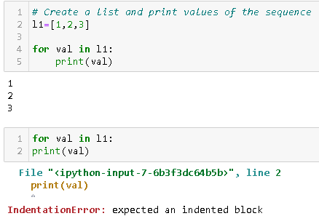
Examples –

Slide 5
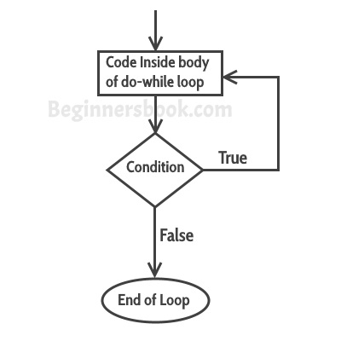
While Loop statement
The while loop in Python is used to iterate over a block of code as long as the test expression (condition) is true.
The body of the loop is entered only if the test_expression evaluates to True.
After one iteration, the test expression is checked again.
This process continues until the test expression
evaluates to False.
Syntax → Flowchart →
while condition:
statement

Slide 6
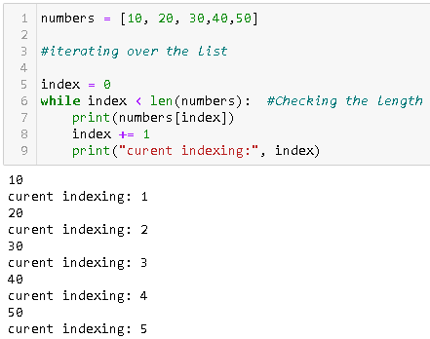
Examples

Slide 7
While loop with else statement
Same as that of for loop, we can have an optional else block with while loop as well.
The else part is executed if the condition in the while loop evaluates to False. The while loop can be terminated with a break statement.
In such case, the else part is ignored. Hence, a while loop's else part runs if no break occurs and the condition is false.
Syntax →
while condition:
statement1
else:
statement2

Slide 8
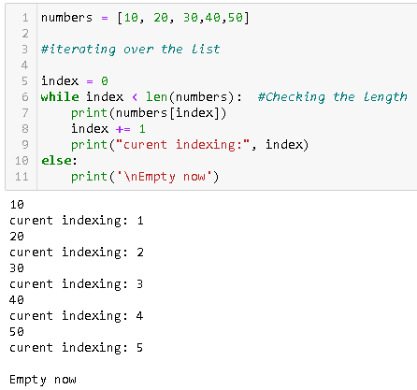
Examples -

Slide 9
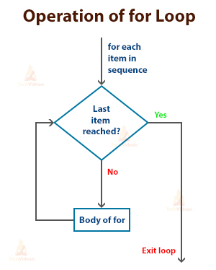
For Loop statements
The for loop is another repetitive control structure, and is used to execute a set of instructions repeatedly, until the condition becomes false.
The for loop in Python is used to iterate over a sequence (list, tuple, string) or other iterable objects. Iterating over a sequence is called traversal.
Here, element is the variable that takes the value of the item inside the sequence on each iteration.
Loop continues until we reach the last item in the sequence.
Syntax → Flowchart →
For value in sequence:
statement(s)

Slide 10
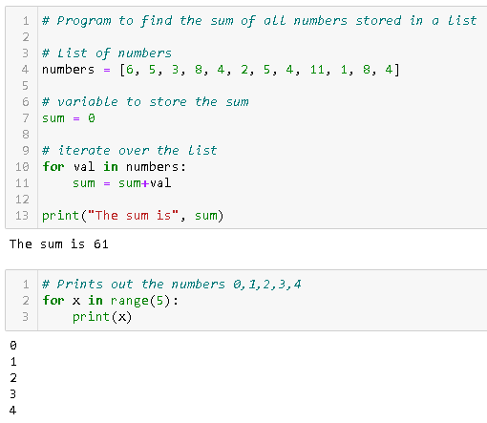
Examples -

Slide 11
For loop with else
A for loop can have an optional else block as well. The else part is executed if the items in the sequence used in for loop exhausts.
Break statement can be used to stop a for loop. In such case, the else part is ignored.
Hence, a for loop's else part runs if no break occurs.
Syntax →
for value in sequence:
statement(s)
else:
statement(s)

Slide 12
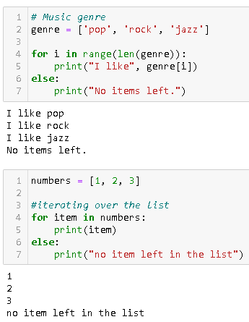
Examples -

Slide 13
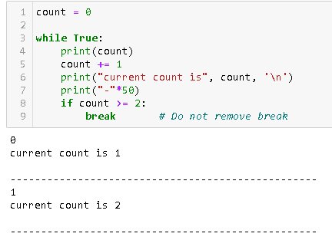
Break statement
When the for-loop starts executing, it will check the if-condition. If true, the break statement is executed, and the for–loop will get terminated. If the condition is false, the code inside for-loop will be executed.
When the while loop executes, it will check the if-condition; if it is true, the break statement is executed, and the while –loop will exit. If if the condition is false, the code inside while-loop will get executed.

Slide 14
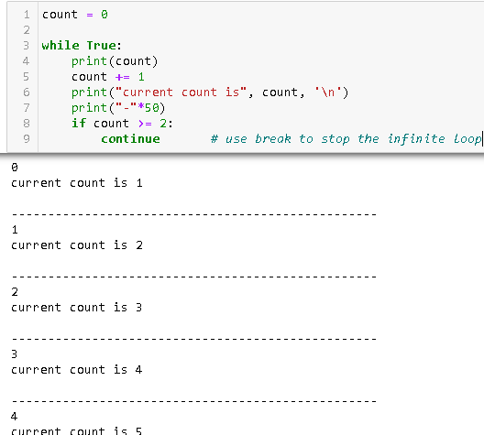
Continue statement
The continue statement skips the code that comes after it, and the control is passed back to the start for the next iteration.
The for –loop, loops through my_list array given. Inside the for-loop, the if-condition gets executed. If the condition is true, the continue statement is executed, and the control will pass to the start of the loop for the next iteration.

Slide 15
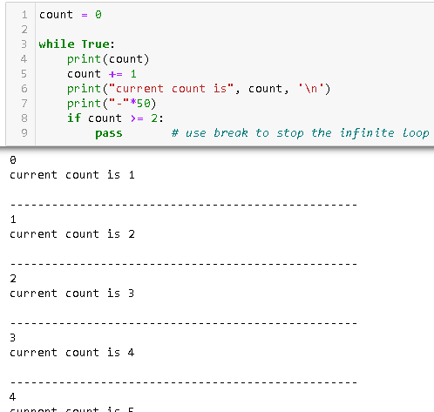
Pass statement
Python pass is a null statement. When the Python interpreter comes across the across pass statement, it does nothing and is ignored.
The pass statement can be used inside the body of a function or class body. During execution, the interpreter, when it comes across the pass statement, ignores and continues without giving any error.

Slide 16
Summary
Python loop | Working Code for all exercises
Code for while loop | val=0 while (val<4): print (val) val+=1
For Loop Simple Example | val=0 for x in range (2,7): print (val)
Use of for loop in string | Months = ["Jan","Feb","Mar","April","May","June"] for mnth in Months: print (mnth)
Use break-statement in for loop | for val in range (10,20): if (val == 15): break print (val)
Use of Continue statement in for loop | for val in range (10,20): if (val % 5 == 0): continue print (val)
Code for "enumerate function" with "for loop" | Months = ["Jan","Feb","Mar","April","May","June"] for index, mnth in enumerate(Months): print (index,mnth)

